Slide 1

Automotive Technology:
A Systems Approach, 8e
Chapter 1: Careers in the Automotive Industry
Rob Thompson and Jack Erjavec, Automotive Technology: A Systems Approach, 8th Edition. © 2025 Cengage. All Rights Reserved. May not be scanned, copied or duplicated, or posted to a publicly accessible website, in whole or in part.

Slide 2
Icebreaker: Interview Simulation
The class will be broken up into pairs of students.
Each pair of students will interview each other about their career interest and experience in the automotive field.
Then each pair will introduce each other to the class.
As you respond to your interviewer’s questions, think about a personal story that connects your experience to topics that are relevant to this course.

Slide 3
Chapter Objectives
01.01 Describe the various types of jobs available in the automotive industry.
01.02 Identify the many job opportunities available to people with an automotive technology background.
01.03 Describe career opportunities related to the automotive industry. Explain the types of training available for technicians and why continuing education is important.
01.04 Describe the requirements for ASE certification as an automotive technician and a master auto technician.
01.05 Explain the requirements for automotive training programs to achieve ASE Accreditation.

Slide 4
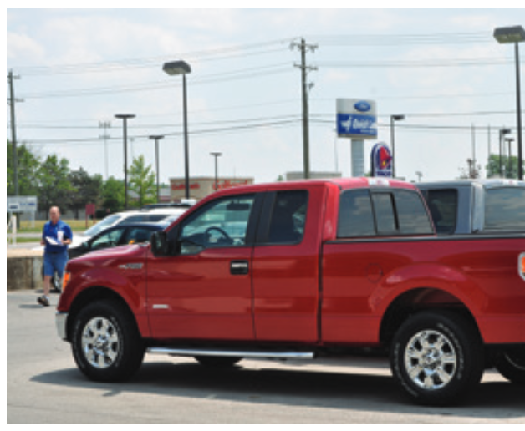
The Automotive Industry (1 of 2)
The U.S. automotive industry is no longer dominated by the “big three”—GM, Ford, and Chrysler.
The industry is now global.
While GM has the highest rating in global sales, Toyota is a close second.
Shown, the Ford F-150 pickup has been the best-selling vehicle in America for many years.

Slide 5
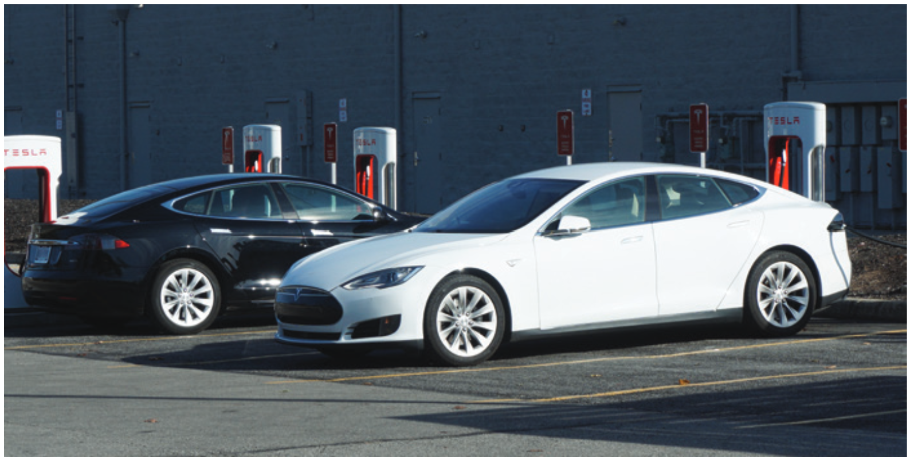
The Automotive Industry (2 of 2)
Automobile manufacturers have joined together, or merged, to reduce costs and increase market share.
This cooperation between manufacturers has given customers more selection in vehicles.
It also has created new challenges for automotive technicians, because the different models come with different systems and options.

Slide 6
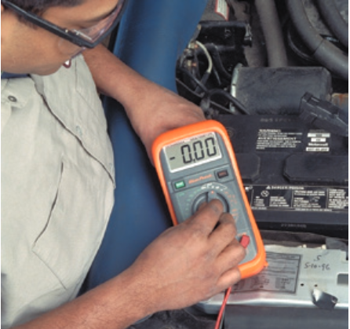
The Importance of Auto Technicians
Objective 01.01 Describe the various types of jobs available in the automotive industry.
An understanding of electronics is a must for all automotive technicians.
Computers and electronic devices are used to control the operation of nearly all systems of an automobile.

Slide 7
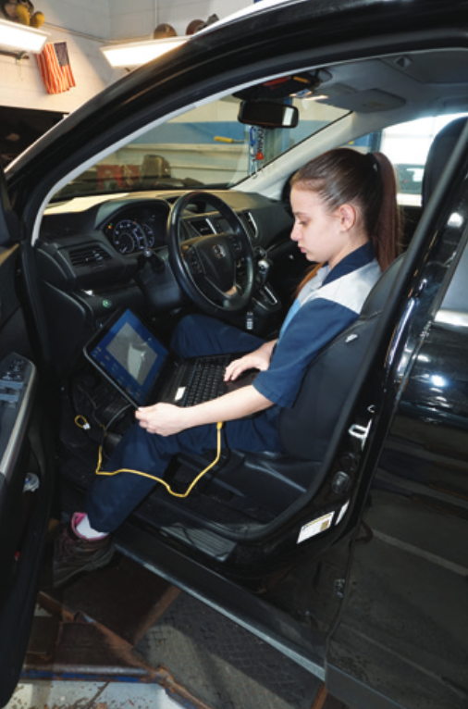
The Need for Quality Service (1 of 5)
Currently, there is a great shortage of qualified automotive technicians.
Today’s vehicles are complex, and a great amount of knowledge and understanding is required for good diagnostic skills.
Today’s technicians must be able to identify and solve problems the first time the vehicle is brought into the shop.

Slide 8
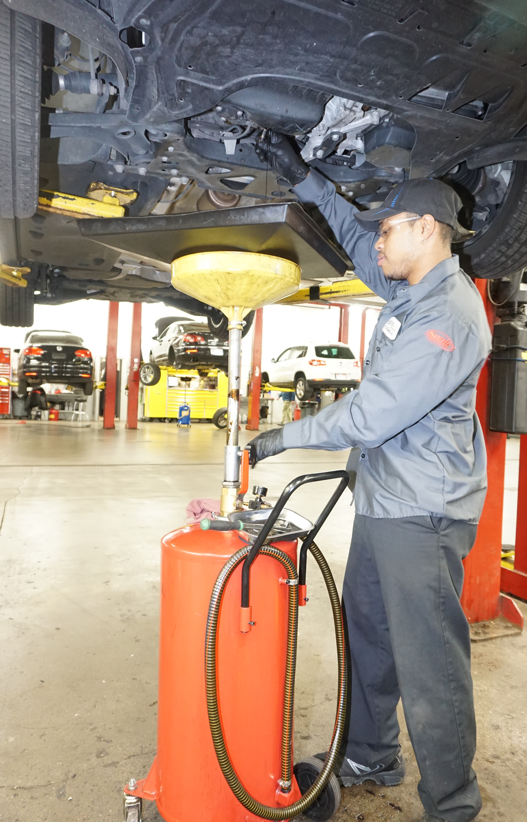
The Need for Ongoing Service: (2 of 5)
Electronic controls have not eliminated the need for routine service and scheduled maintenance.
Each automobile manufacturer recommends that certain maintenance services be performed according to a specific schedule.
These maintenance procedures are referred to as preventive maintenance (PM) because they are designed to prevent problems.

Slide 9
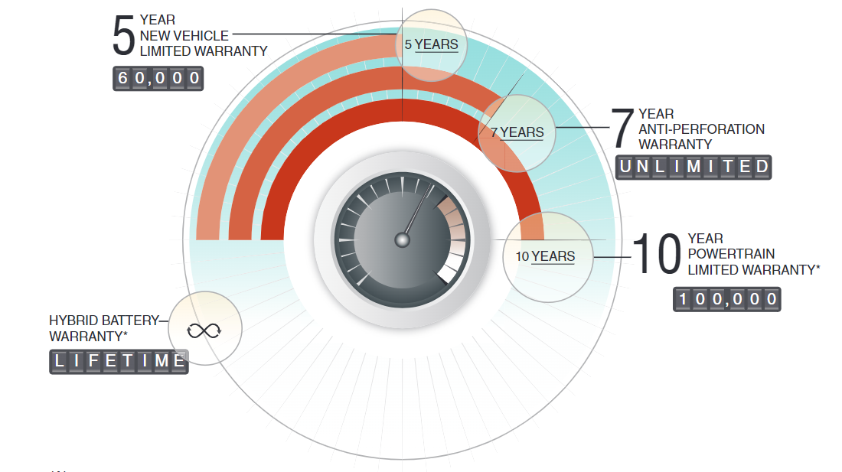
The Need for Ongoing Service: (3 of 5)
Warranties
  A new car warranty is an agreement by the auto manufacturer to have its authorized dealers repair, replace, or adjust certain parts if they become defective.
  Most manufacturers also provide a separate warranty for the powertrain (engine, transmission, and so on) that covers these parts for a longer period than the basic warranty.

Slide 10
The Need for Ongoing Service: (4 of 5)
Warranties
  There are also two government-mandated warranties: the Federal Emissions Defect Warranty and the Federal Emissions Performance Warranty.
  The Federal Emissions Defect Warranty ensures that the vehicle meets all required emissions regulations, and that the vehicle’s emission control system works as designed and will continue to do so for 2 years or 24,000 miles.
  The Federal Emissions Performance Warranty covers the catalytic converter(s) and engine control module for a period of 8 years or 80,000 miles (129,000 km).

Slide 11
The Need for Ongoing Service: (5 of 5)
Warranties
  All warranty information can be found in the vehicle owner’s manual.
  Make sure to tell the customer of any known warranties before proceeding with your work.
  Aftermarket warranties are also offered, which are typically offered on used vehicles.

Slide 12
Knowledge Check (1 of 2)
Why is an understanding of electronics a must for all automotive technicians?

Slide 13
Knowledge Check Answer (1 of 2)
Why is an understanding of electronics a must for all automotive technicians?
Answer: Computers and electronic devices are used to control the operation of nearly all systems of an automobile.

Slide 14
Typical Maintenance Schedule (1 of 4)
5,000 Miles or 6 Months
Replace engine oil and oil filter
Reset service reminder indicator display
Rotate tires
Visually inspect brake linings and fluid level
Inspect wiper blades
Check windshield washer fluid level and system
Check tires and spare wheel for pressure and wear
Additional items for special operating conditions
Rotate tires and reset TPMS
Inspect ball joints and dust covers
Inspect drive shaft boots
Inspect air filter
Inspect steering linkage and boots
Re-torque drive shaft bolt
Tighten nuts and bolts on chassis

Slide 15
Typical Maintenance Schedule (2 of 4)
15,000 or 18 Months
Same as 5,000 miles or 6 months, plus:
Inspect battery and cables
Check and replenish coolant level
Clean or replace cabin air filter
Replace fuel filter
Lubricate hinges
Rotate tires and reset TPMS
Inspect the Following:
Engine for leaks
Exhaust for leaks
Transmission for leaks
Final drive(s) for leaks
Drive belts
All lighting
Horn operation
Ball joints and dust covers
Drive shaft boots
Drive axle play
Water drain for A/C
Engine air filter
Steering linkage and boots
Re-torque drive shaft bolt
Tighten nuts and bolts on chassis

Slide 16
Typical Maintenance Schedule (3 of 4)
30,000 miles or 36 Months
Same as 5,000 miles or 6 months, plus:
Replace cabin filter
Rotate tires and reset TPMS
Replace engine air filter
Additional items for special operating conditions: Same as 50,000 or 6 months.
In addition, inspect the following:
Brake lines and hoses
Differential oil
Engine coolant
Exhaust pipes and mountings
Fuel lines and connections, fuel tank band and fuel tank vapor system hoses
Fuel tank cap gasket
Radiator core and condenser
Steering gear box
Steering linkage and boots
Transmission fluid or oil

Slide 17
Typical Maintenance Schedule (4 of 4)
45,000 Miles or 54 Months
Same as 15,000 miles and 18 months
Additional items for special operating conditions: Same as 6,000 miles and 6 months
60,000 Miles or 72 Months
Same as 15,000 miles and 18 months, plus:
Inspect:
  Drive belts
  Engine valve clearance
Additional items for special operating conditions: Same as 6,000 miles and 6 months, plus:
Replace differential oil
Replace transmission oil or fluid
75,000 Miles or 84 Months
Same as 15,000 miles and 18 months, plus:
Check power-steering fluid
Inspect:
  Drive belts
  Engine valve clearance
Additional items for special operating conditions: Same as 6,000 miles and 6 months

Slide 18
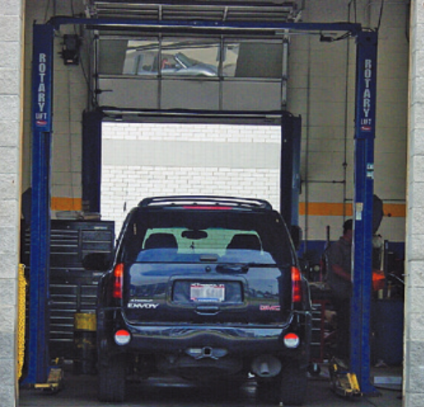
Career Opportunities (1 of 3)
Objective 01.01 Describe the various types of jobs available in the automotive industry.
Automotive technicians can enjoy careers in many different types of automotive businesses.
Independent Service Shops
  They may service all types of cars or specialize in a particular brand or vehicle system.

Slide 19
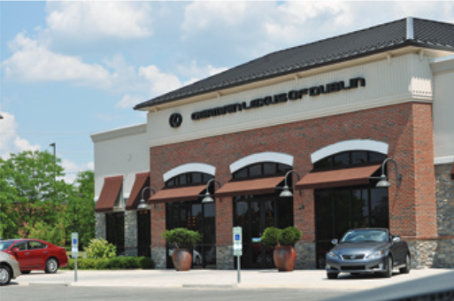
Career Opportunities (2 of 3)
Dealerships
  They serve as a link between the Original Equipment Manufacturer (OEM) and the customer.
  They sell new vehicles but also service vehicles under warranty, perform recalls, and customers.

Slide 20
Career Opportunities (3 of 3)
Franchise Repair Shops
  They are usually run by large companies such as tire manufacturers. They do not normally service and repair all of the systems of the automobile. Similar to a chain restaurant model.
Store-Associated Shops
  These are usually associated with large department stores.
Fleet Service and Maintenance
  They may be a large business or municipality. Technicians repair and maintain the fleet, they do not work on customer vehicles.

Slide 21
Knowledge Check (2 of 2)
What system do most manufacturers provide a separate and often longer warranty for?

Slide 22
Knowledge Check Answer (2 of 2)
What system do most manufacturers provide a separate and often longer warranty for?
Answer: Most manufacturers also provide a separate warranty for the powertrain (engine, transmission, and so on) that covers these parts for a longer period than the basic warranty

Slide 23
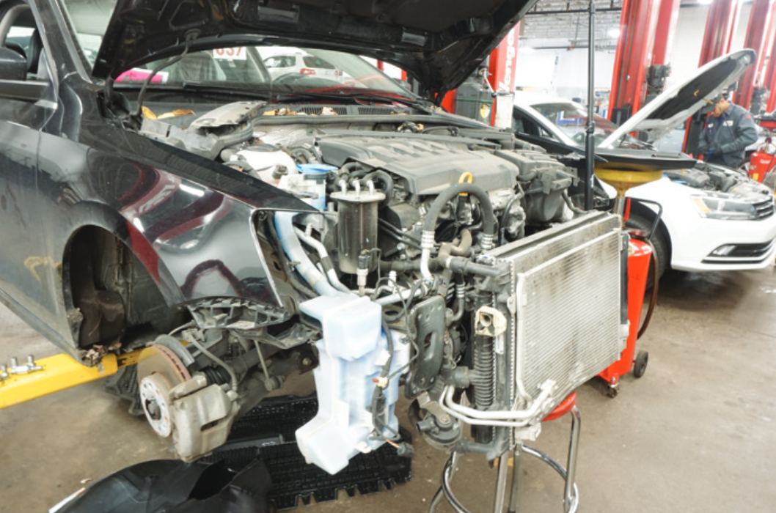
Job Classifications (1 of 4)
Objective 01.02 Identify the many job opportunities available to people with an automotive technology background.
Service Technician
  Diagnoses vehicle problems, performs all necessary tests, and competently repairs or replaces faulty components.
Shop Foreman
  Helps technicians with more difficult tasks and serves as the quality control expert.

Slide 24
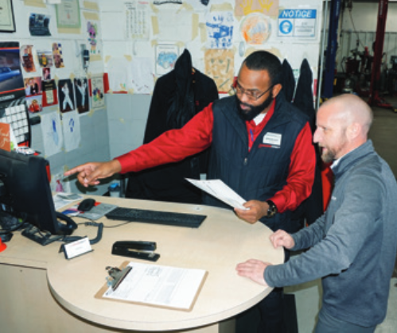
Job Classifications (2 of 4)
Service Advisor
  Greets customers and records their concerns on the repair order.

Slide 25
Job Classifications (3 of 4)
Service Manager
  Is responsible for the service department which is the entire shop operation.
Service Director
  Oversees service, body, and parts departments. Typically exists only in a new car dealership since they have parts and service departments.

Slide 26
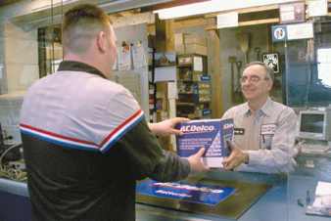
Job Classifications (4 of 4)
Parts Counter Person
  Sells parts directly to customers and supplies parts to technicians
Parts Manager
  Oversees ordering replacement parts and runs parts department

Slide 27
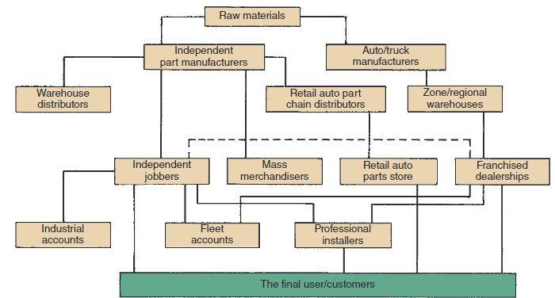
Related Career Opportunities (1 of 2)
There are many other job opportunities directly related to the automotive industry.
Parts Distribution
  A network of businesses that supplies replacement parts to independent service shops, car and truck dealerships, fleet operations, and the public. This may include Warehouse Distributors (WD).

Slide 28
Related Career Opportunities (2 of 2)
Marketing and Sales
  Knowledgeable people to represent and sell their products
Other Career Opportunities
  Automobile and truck recyclers
  Insurance company claims adjusters
  Auto body shop technicians
  Trainers for various manufacturers
  Instructors for automotive training or educational program

Slide 29
Training for a Career in Automotive Service (1 of 4)
Objective 01.03 Describe career opportunities related to the automotive industry. Explain the types of training available for technicians and why continuing education is important.
Those interested in a career in auto service can receive training in various formal school settings.
Student Work Experience
  There are many ways to gain work experience while you are a student.
Job Shadowing Program
  You follow an experienced technician or service writer.

Slide 30
Training for a Career in Automotive Service (2 of 4)
Cooperative Education and Apprenticeship Programs
  These programs are usually 2 years in length. One year is spent in school and the other in a dealership or service facility.
Mentoring Program
  You experience the duties and responsibilities of a technician while you have someone who is successful to use as an expert.

Slide 31
Training for a Career in Automotive Service (3 of 4)
Postgraduate Education
  These programs train individuals to work on particular vehicles.
Part-Time Employment
  It gives good experience, some income, and a good start in getting a great full-time position after you have completed school.

Slide 32
Training for a Career in Automotive Service (4 of 4)
The Need for Continuous Learning
  A professional technician constantly learns and keeps up to date.
  You need to commit yourself to lifelong learning.
  There are many ways in which you can keep up with the changing technology.

Slide 33
Discussion Question
In small groups or as a class, discuss some of the job opportunities available in the automotive industry.
  Which jobs interest you most, and why?
  What are ways to prepare for the job you want?

Slide 34

ASE Certification
Objective 01.04 Describe the requirements for ASE certification as an automotive technician and master auto technician.
The National Institute for Automotive Service Excellence (ASE) has established a voluntary certification program for automotive, heavy-duty truck, and auto body repair technicians along with parts specialist certifications.
Becoming ASE certified requires passing a specific test and having a verified 2 years of related work experience.
We will focus on the automotive area of ASE certification.

Slide 35
Primary ASE Areas of
Automotive Certification
A1 Engine repair
A2 Automatic transmission/transaxle
A3 Manual transmissions and drive axles
A4 Suspension and steering
A5 Brakes
A6 Electrical systems
A7 Heating and air conditioning
A8 Engine performance
A9 Light duty diesel
L1 Advanced Engine Performance
L2 Electronic Diesel Engine Diagnosis

Slide 36
Other ASE areas of Automotive Certification
G1 Maintenance and Light Repair Technician
L3 Light Duty Hybrid/Electric Vehicle Specialist
L4 Advanced Driver Assist Systems (ADAS) Specialist
xEV high-voltage electrical safety certifications for light, medium, and heavy-duty vehicles

Slide 37
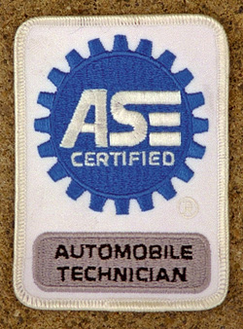
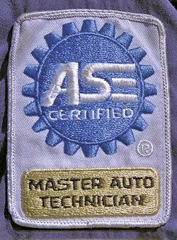
Types of ASE Certification
One or more areas
All eight areas of automobile certification: A1–A8

Slide 38
ASE Student Certification
Computer-based tests
Certification valid for two years
Tests available for
  Automotive
  Collision Repair and Refinishing
  Medium and Heavy-Duty Truck

Slide 39

ASE Education Foundation Program Accreditation
01.05 Explain the requirements for automotive training programs to achieve ASE Accreditation.
This is not to certify an individual, but to certify a training program that a student may attend.
Standardizes program with other automotive programs.
Program must show documentation for what is covered.
Programs must pass an evaluation.

Slide 40
Chapter Reflection
Please take a moment to compare your perception of the automotive industry before and after you studied this chapter. Then respond to the following questions in one or two paragraphs. Use 150–200 words in your reflection.
Did anything in this chapter change your thinking about automotive careers? Describe what you learned and how it changed your ideas.
If your basic perception has not changed, describe something in this chapter that reinforced your ideas.

